Slide 1
Overview of Separation Logic
He Xiao
Department of Computer Science, UIUC
2015-10-28

Slide 2
Motivation of Separation Logic
Shared mutable data structures are prevalent in modern programming languages
  Aliasing
  Address arithmetics
  Standard Hoare Logic does not support these features

Slide 3
Motivation Cont.
int *a = new int;
*a = 5;
int *b = a;
*b = 22;
cout << "a is " << *a << endl;
cout << "b is " << *b << endl;

Slide 4
Motivation Cont.
{*a = 5 /\ *b = 5}
*b := 22;
{*a = 22 /\ *b = 22}
NOT a Hoare Triple

Slide 5
Separation Logic came to rescue
Extend Hoare Logic in three aspects to handle shared mutable data structures
  simple imperative language
  assertion language
  specification

Slide 6
Overall structure of S.L. specification
Program
{Pre} C {Post}
Assertions

Slide 7
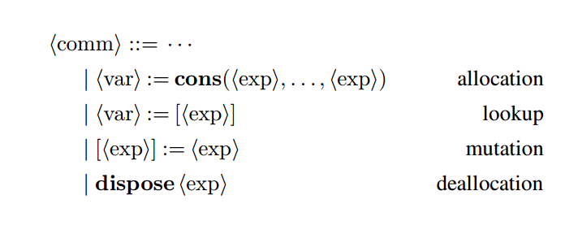
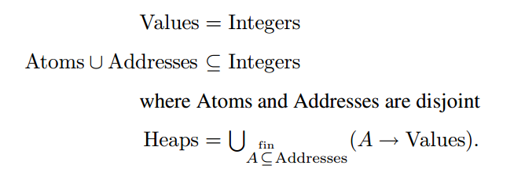
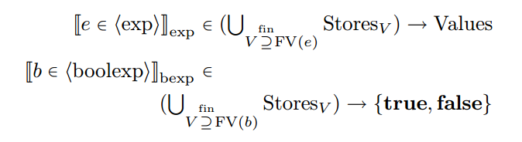

Extended Imperative P.L.

Slide 8
Extended Assertion Languages

Slide 9
Similar program specification

Slide 10
Back to the previous problem
//Translated to the simple imperative language
a := cons(5); //alloc
b := a; //normal assignment
{a -> 5 /\ b -> 5}
[b] := 22; // mutation
{a -> 22 /\ b -> 22}

Slide 11
Non aliasing is also OK
int data = 5;
int *a = new int;
*a = data;
int *b = new int;
*b = data;
*b = 22;
//Separation Logic Spec
{emp}
data := 5;
a := cons(data);
b := cons(data);
{a -> 5 * b -> 5}
[b] := 22;
{a -> 5 * b -> 22}

Slide 12
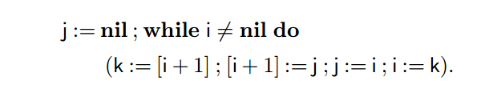
Verify list-reversing program

Slide 13
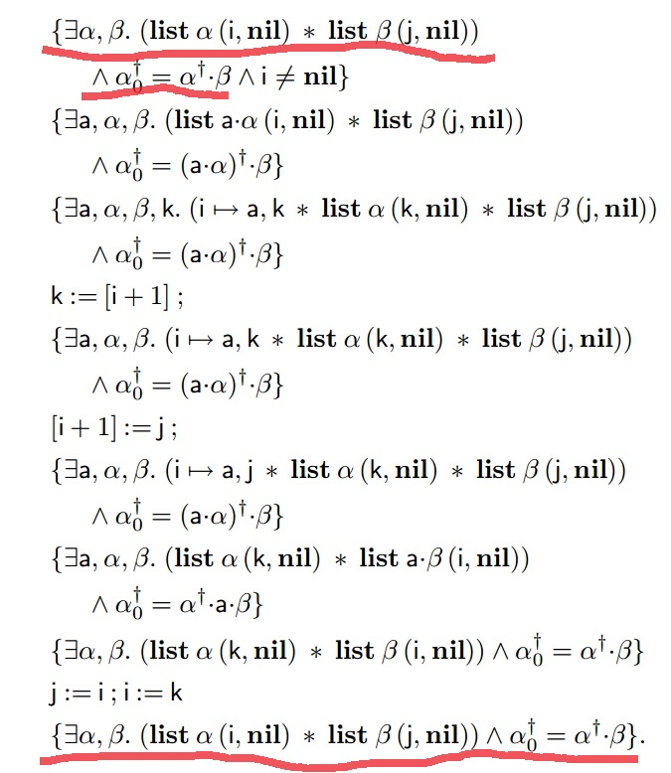

Slide 14
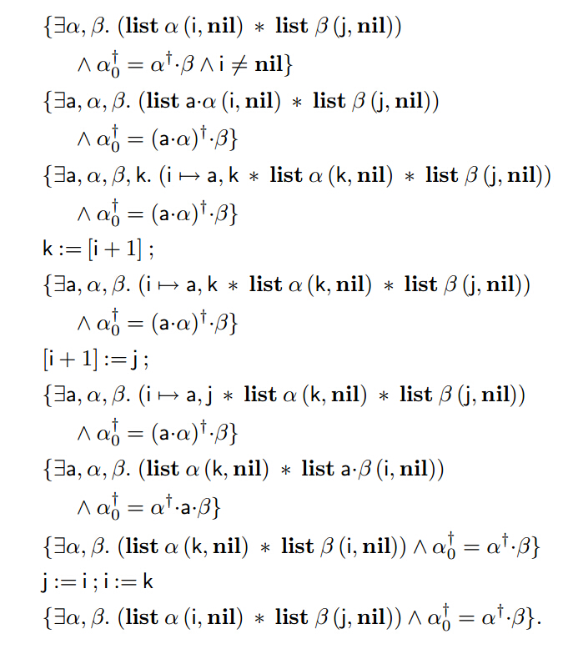

Slide 21
By Applying Consequence rule and Composition rule
{LI /\ guard} LB {LI}

Slide 22
Verify tree-copying procedure

Slide 23
Related Work
Matching Logic (Grigore Rosu, RTA'15)
  separation logic is a particular matching logic theory
  Separation logic formulae can be encoded in matching logic and get solution.

